Slide 1

Cursor control by hand gestures
Done By - Priya Dharshini T
Roll No. - 2028MCA0040
Reg. No. - 67220200053
Guidance - Dr. S. Bose

Slide 2
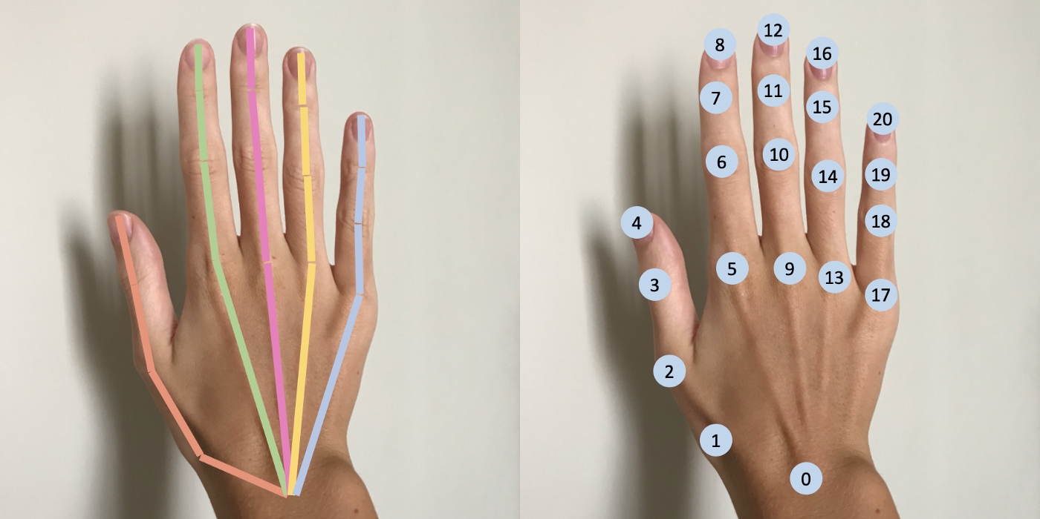
Agenda
Abstract
Existing System
Architecture
Proposed System
Hardware Req.
Software Req.
Work Plan
References

Slide 3
Abstract
World swifts towards technology much faster every day such as AI, VR, etc. The results of such development works (like Meta VR World, VR Games – Beat Saber, etc.) have already created a lot of hype with the users. This led to the development of gadgets which the users can wear to interact with VR. Several products for VR interaction have been made worldwide for hands, legs, & body tracking. These devices would cost more & would also be bulky to carry around. So, to interact with such great VR technologies, computer vision can be used which can take video inputs from the webcam. This method will provide an efficient & powerful way to unleash the full potential of controlling basic action with just the camera. These basic actions may vary from tracking the finger movements to moving the cursor & to do a click when two fingers are joined. A more advanced research phase would be to track the whole-body movements of a human standing in front of the camera and feed them as inputs to the VR worlds. This project will serve as a start line for a powerful computer vision use case which can be widely implemented in several gesture control applications.

Slide 4
Existing System
Prior to the cursor control by hand gestures, VR gadgets such as gloves, kneecaps, head band, etc. all are equipped with a pair of motion detector sensors that in turn increase the cost of the manufactured product. Also, some of these products seemed heavy to carry around; few of them were wear & tear. Over the last five years deep learning practitioners have researched with tons of GPU to produce state of the art detection models. But a detection model can only detect the subject. To bring out more functionality, diverse features must be derived based on the application usage. A more generalized version of Gesture detection should also be made open source so that several other practitioners can get benefited from the feature & to make it a bit more generalized.

Slide 5
Proposed System
For a proposed objective, the plan is to produce a platform where the user can interact with the computer's cursor using a computer vision technique - "Media pipe”, an advanced deep neural network model. This proposed system is considered to have strong scope around the Virtual Reality worlds where the computer must track the motions of several human joints to bring a better virtual experience using a camera. Hand Gestures are tracked using Media Pipe to detect hand poses and signs which can be correlated towards the cursor movement of the computer. Several Cursor operations like clicks, movements, & tapping can be achieved via the computer vision model (without the mouse).

Slide 6
Hardware Requirements
Processor : Intel Core i5 Processor
Speed : 1.7 GHz
RAM : 8GB (min)
Hard Disk : 500MB
Keyboard : Standard Windows Keyboard
Webcam : Integrated
Monitor : LCD/LED

Slide 7
Software Requirements
Operating System: Windows7/10
Language: Python
IDE: VS Code
Modules: Open CV, Media Pipe, AutoPy, NumPy

Slide 8

The way to get started is to quit talking and begin doing.
Walt Disney

Slide 9
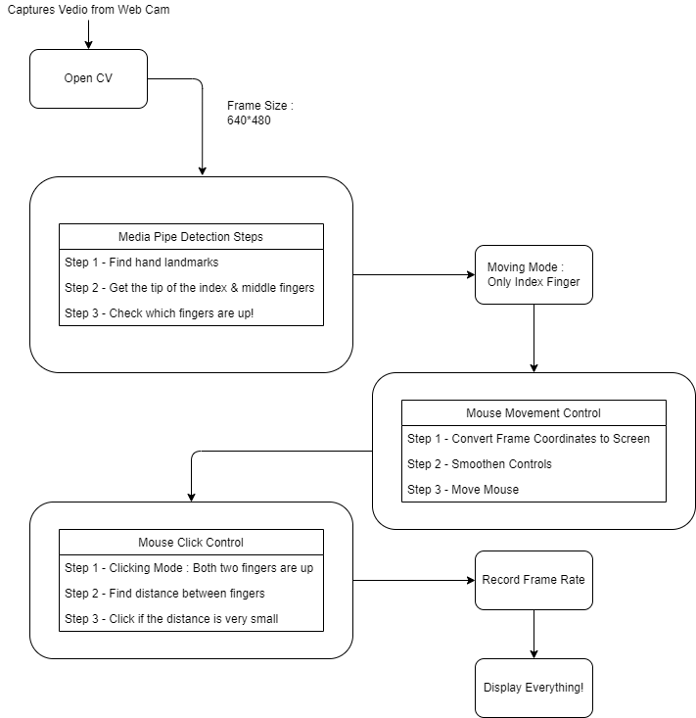
System Architecture
Proposed Algorithm:
Video Capture – Open CV
Hand Detection with Media Pipe Hand Tracking
Moving Mode
Mouse Movement Sync
Click Mode
Record Frame Rate
Display Output

Slide 10
Project Work Plan
Project Work Plan
Cursor Control by Hand Gestures
Done by – Priya Dharshini T
S. No. | WORK | STATUS | TIMELINE
1. | Capture video using Open CV | Completed | -
2. | Detection using Media Pipe Hand Tracking | Completed | -
3. | Cursor Moving Mode | In progress | 2 weeks
4. | Mouse Movement Control | In progress | 2 weeks
5. | Mouse Click Mode | In progress | 2 weeks
6. | Capture Frame Rate | In progress | 2 weeks
7. | Publish the output for reference | In progress | 2 weeks

Slide 11
References
Python
Deep Learning
https://www.w3schools.com/python/
https://docs.opencv.org/4.6.0/
https://google.github.io/mediapipe/solutions/hands
https://www.tensorflow.org/

Slide 12
Thank You
A Project by Priya Dharshini T

